Slide 1

Using an Adapted Jake Knapp’s Design Sprint Approach to Create a BBC Bitesize AR Application

Slide 2

The sprint team
Christell Ann Mataac
David Hynes
James Clare
Lewis Karisa
Nazmi Gargaliev
Shai Vure
Tim Davies
Notes:
Introduction of team members

Slide 3
Overview
The problem we were trying to solve
Overall structure of design sprint
Key findings of each day
Actions taken at the end of sprint

Slide 4
Project Brief
Create AR component for BBC bitesize
Enhance the learning experience of 7 to 11 year olds in the home environment
Product designed for tablet or smartphone use
Produce prototype application by the end of the project

Slide 5
Design Sprint Structure
Day 1
Day 2
Day 3
Monday
Map
Tuesday
Sketch
Wednesday
Decide
Thursday
Prototype
Friday
Test

Slide 6
Day 1 Map & Sketch

Slide 7
Project Goals
6 months
1 year
5 years
Provide fun interactive AR learning experience for kids aged 7 to 11
Additional subjects added to application
Interactive learning experience mirrors all subjects on bitesize
Notes:
These goals were discussed and written on the whiteboard.
This was crucial for determining the content of the prototype.
It was here that the team decided that the prototype should only contain one subject in order to meet the time constraints of the sprint.
The team kept these goals in mind throughout the project which allowed the prototype to be designed in such a manner that it can be easily scaled in the future to meet the long-term goals.

Slide 8
BBC Bitesize Issues
Incorrect material being shown on mobile application
Application displayed GCSE level rather than age appropriate material
Restricts users of a younger age
Lack of immersion
Most content was static
Some videos and interactive quizzes
Content may become obsolete

Slide 9
Sprint Questions
How will the app capture attention?
How will it help learning better than the existing website?
How do we make the experience different?
How can it work in every environment?
How do we make it appropriate for the ages 7 to 11?
Is it feasible for it to cover just one subject? (Can it scale?)
What will make kids want to come back?
Notes:
These were visible for the entirety of the project, this ensured the app satisfied each of these questions as it was being designed.
It also allowed for potential obstacles to be identified early on.

Slide 10
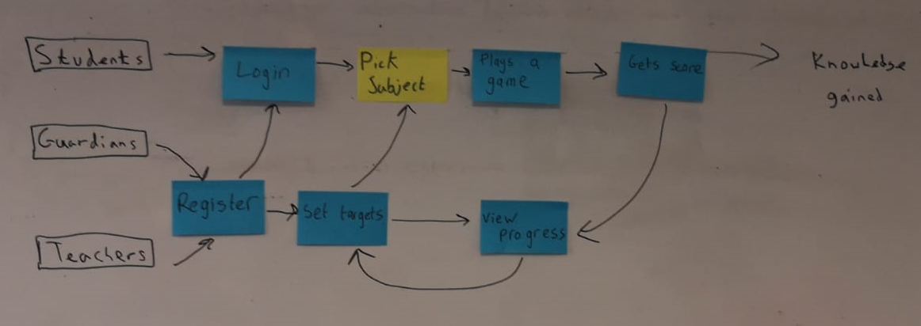
Map
Outlines the flow of the app
Customers and key players are placed on the left with the goals placed on the right
Notes:
Customers and key players were added first on the left.
The goals were added next on the right.
Finally a flowchart was added between to demonstrate how the customers and key players interact with the product.
The users experience was heavily considered when we created this map, as it is customer centric and focuses upon the story the user will embark upon when they use the app.

Slide 11
Lightning Demos
Individual team members explored different applications by different companies
Team members have 3 minutes each to demonstrate their application to the team
Any good ideas from the demonstrations are noted down on the whiteboard
Notes:
A range of solutions from other apps were explored. Each team member explored an app to derive ideas from it.
This app was demonstrated to the rest of the group, three minutes per demo.
Good ideas were written on the whiteboard.
The interesting aspects of each app were discussed.
This allowed the team to decide if features from other apps could also be adapted or integrated into the app that was to be created.

Slide 12
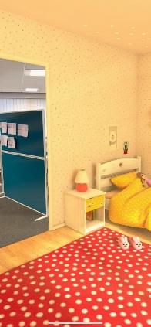
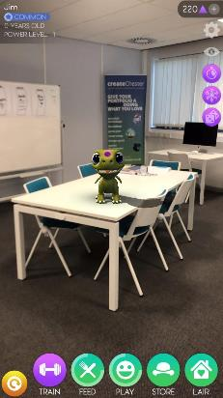
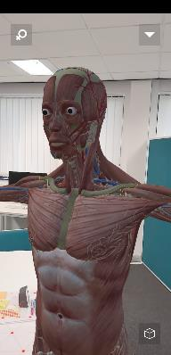
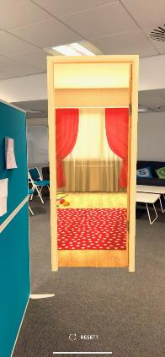
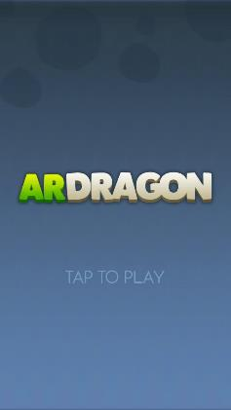
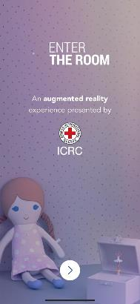
Lightning Demos - Examples

Slide 13
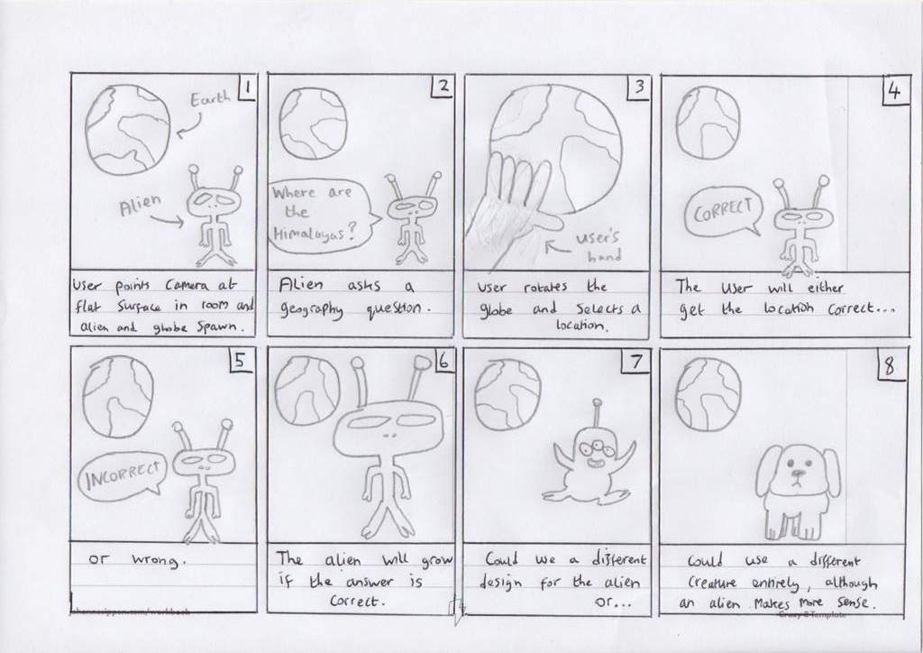
Crazy 8s
A task that involves folding a sheet of papers into 8 frames
1 minute is given per frame to sketch a different variation of the same idea
Fast-paced task
Notes:
A Crazy 8 involves folding a sheet of paper to create eight frames.
It is a fast paced exercise in which each team member individually sketches their strongest ideas in a rapid manner.
The aim is to create eight variations of the same idea.
The team spent 1 minute per panel to quickly sketch their best initial ideas.
An example of a Crazy 8 produced by a team member can be seen here.

Slide 14
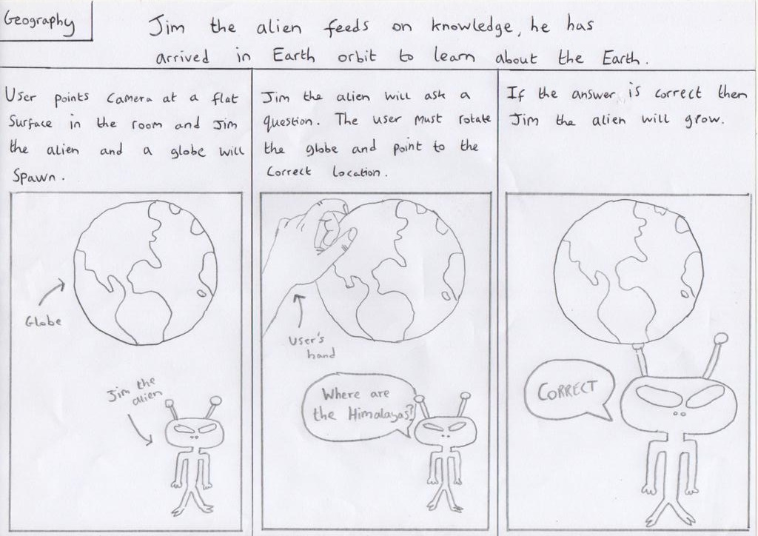
Solution Sketches
Three-panel storyboard of a solution
Needs to be self-explanatory and catchy title
Sketch drawing can be ugly, words matter
Notes:
The solution sketch takes the form of a three-panel storyboard.
These were kept anonymous, self-explanatory and contained a catchy title.
This was important as the team would later attach these sketches to the whiteboard in order to vote on the best ideas.
Anonymity ensured each design was critiqued fairly, the self-explanatory nature would ensure everybody understood it, and a catchy title allowed for attention to be drawn to each sketch.
This will be explained further when we discuss Day 2.

Slide 15
Day 1 Key Findings
A collection of possible solutions were available for the team to take forward.
The goals, sprint questions and stakeholders were now identified.
The flow of the app had been outlined in the form of a map
Initial ideas had been sketched.
Notes:
The solution sketch takes the form of a three-panel storyboard.
These were kept anonymous, self-explanatory and contained a catchy title.
This was important as the team would later attach these sketches to the whiteboard in order to vote on the best ideas.
Anonymity ensured each design was critiqued fairly, the self-explanatory nature would ensure everybody understood it, and a catchy title allowed for attention to be drawn to each sketch.
This will be explained further when we discuss Day 2.

Slide 16
Day 2 Decide & Prototype

Slide 17
Solution Sketches Review
All solution sketches were pinned to the wall
Team members will review each sketch in silence, noting any feature they personally like.
Team members will rate their parts of solutions sketches
Team members placed dots on parts of the sketch they like. This could include the whole sketch
Narratives are created for each solution sketch
Facilitator makes a narrative for sketch, noting features of interest
Other team members will point out features that the facilitator misses

Slide 18
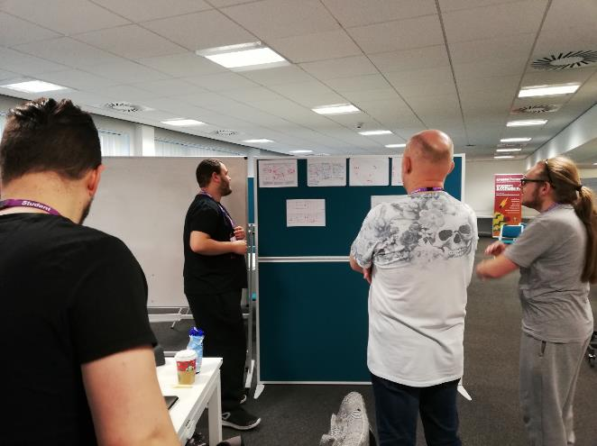
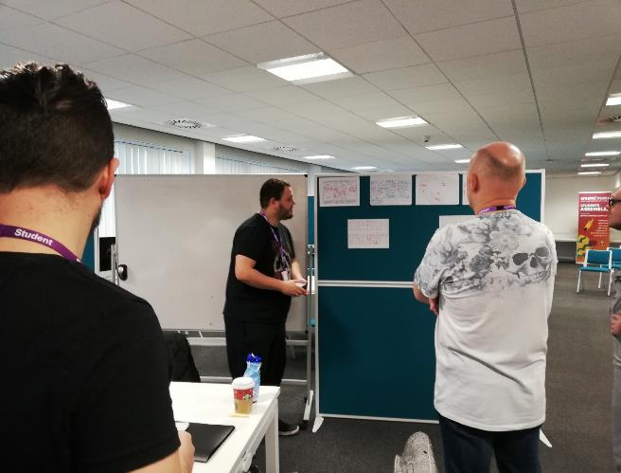
Solution Sketches Review
A vote is held over what solution sketches will be carried forward
Team members will vote on their favourite sketches and give them reasons for their choice.
Decider will take all votes into account, however they will get final vote on the chosen solution sketches

Slide 19
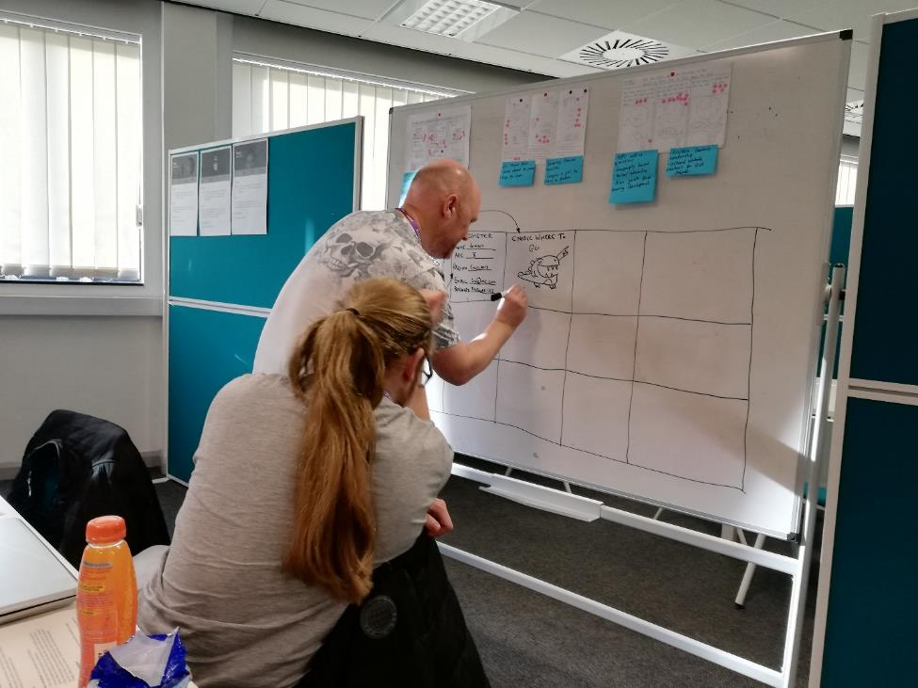
Storyboarding
15 frame grid of the user’s journey through the application
Combines elements of the chosen solution sketches and selected features from dot vote

Slide 20
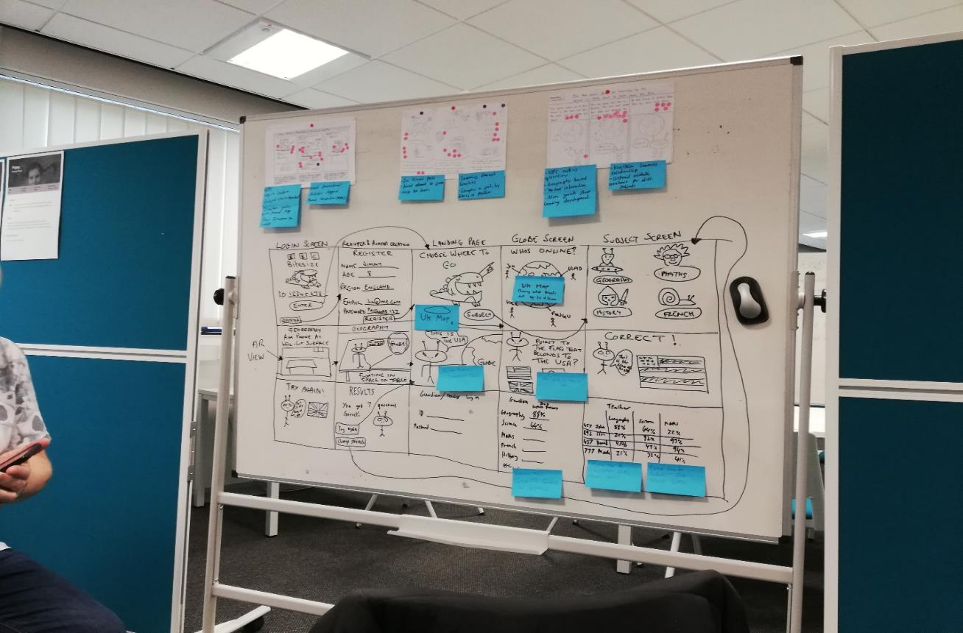
Storyboarding

Slide 21
Prototyping
Creating the most realistic prototype as fast as possible
Using rough tools like Powerpoint or Keynote to make a product fast
Team members are split into different roles
Makers – Create assets for the prototype
Stitchers – Combine assets from makers and text from writers to make prototype
Writers – Create scripts for text that the user will see in application
Interviewers – Create interview questions from prototype

Slide 22

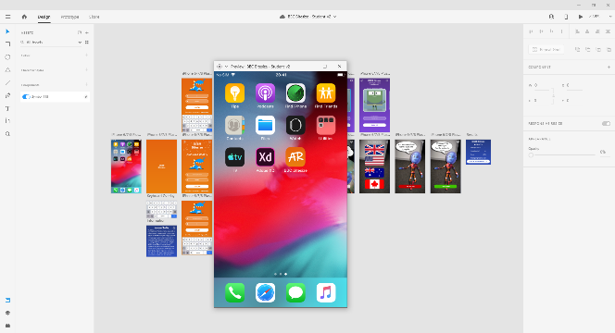
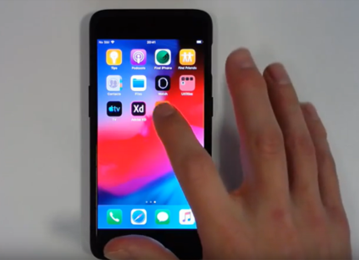
What is Adobe XD?
User Experience design tool.
Ability to create wireframes, mock-ups and prototypes.
Can be displayed as live previews on both desktop and mobile devices
Notes:
Adobe XD was our prototyping software of choice mainly because I / Tim had used it extensively throughout my / his dissertation last year. It had the ability to make anything from wireframe designs to static mock-ups to interactive prototypes that could look and act like the finished product. This experience with the product made it easier to go straight to creating a hi-fidelity prototype using our already created lo-fi designs. It also gave us the opportunity to view the prototype as intended, on a mobile device as the end-user would see it.

Slide 23
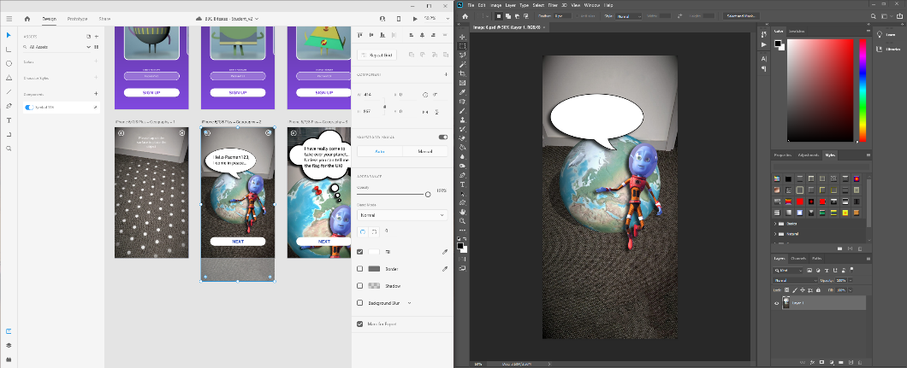
Adobe XD Features
Easy to test on mobile devices.
Assets in XD could be easily amended on the fly using Photoshop.
Simple drag and drop functionality.
Create animations.
Notes:
As mentioned before, the app gave us the opportunity to test our prototype “live” on a mobile device. Assets created for XD using Photoshop could be re-edited and appear changed without having to import or export the asset afterwards. Prototypes could be made to act more like a working app by using animation transitions built into the XD program.

Slide 24

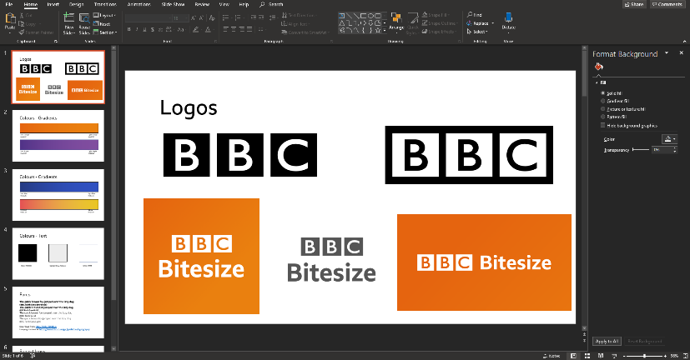
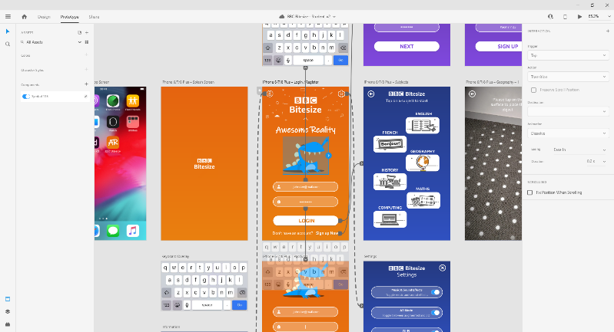
Creating the “ ” App
Using wires in XD
Brand Recognition
Notes:
Brand recognition is a big part of any business or organisation so we used the BBC’s own colour and font schemes to help create the app. Based on the storyboard we had sketched out for the app, we proceeded to create the app in XD. By using artboards for each part of the app, we could then use “wires” to link each artboard together, adding animated transitions between them to mimic the actions of a fully working application.

Slide 25
Key Findings of Day 2
Storyboard of user’s journey of application has been created
Prototype has been created for user to test

Slide 26
Day 3 Testing

Slide 27
Day 3 – Set up
Test room with waiting area, work station, recording equipment
Sprint team in the room taking notes
Two interviewers leading 15 minute interviews

Slide 28
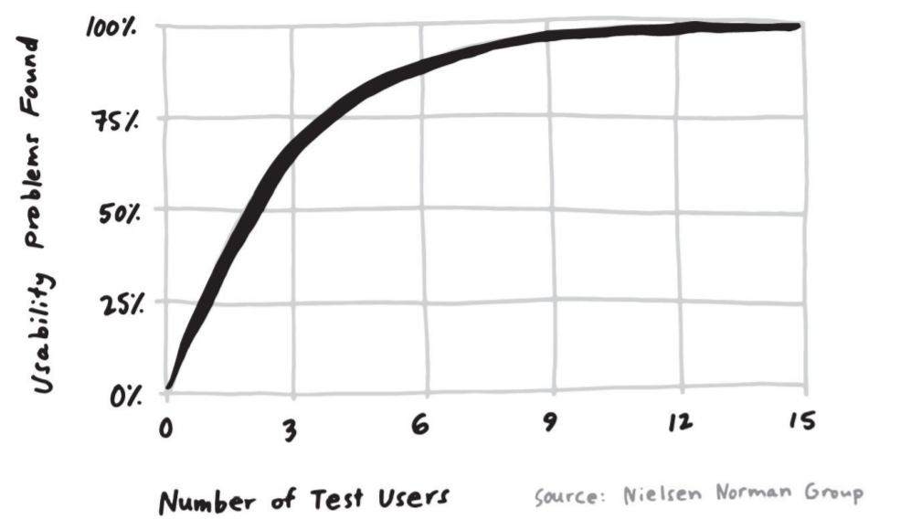
Day 3 – Set up
Three tests would uncover up to 70% of problems.
More tests uncover more issues, but the returns are diminishing.

Slide 29
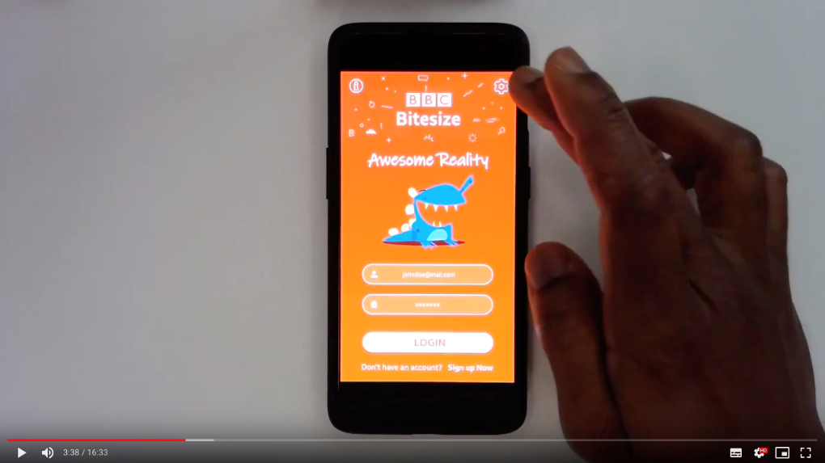
Day 3 – Set up
Three tests would uncover up to 70% of problems.
More tests uncover more issues, but the returns are diminishing.
Interactions were recorded for reviewing later.

Slide 30
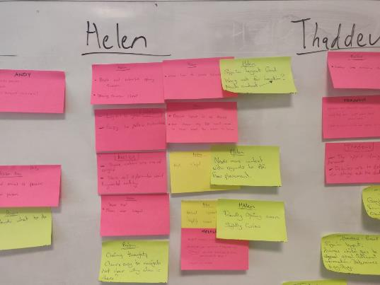
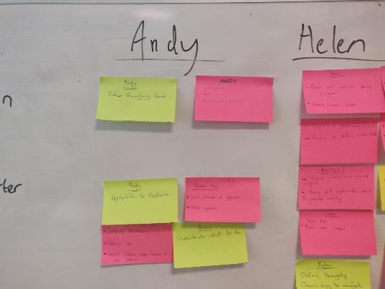
Day 3 – Conclusions
First impressions about the app: A variety of bright colours were used, which are appropriate to audience.
It’s a straight forward app which is friendly and encourages curiosity.
Users easily could manage to find the information (“i”) and settings button to click.
The instructions that users are going to follow are quite clear and users generally interacted well with them.

Slide 31
Day 3 – Conclusions
There is a need of more feedback. If the user answers the questions correctly, the avatar can do a happy face. If not a sad face.
There was some confusion about the reason why the app would need to know where people went to school.
At the end of the quiz, users became confused where to go next. One ended in a loop repeating previous sections from the quiz.
All comments were valuable for giving us a better understanding of UX and importance of creativity.

Slide 32
Any Questions?

